Slide 1
Introduction Covers Chapter# 01 from Text Book
Computer Communication & Networks
(CEN-223)
Fall 2022 (BSE-5A)

Slide 2

Lines of Code
Software Development is everywhere!
Codebases: https://informationisbeautiful.net/visualizations/million-lines-of-code/
Highlights:
Average modern high-end car (100 million) line-of-codes.
Google’s all internet services (2 Billion) line-of-codes.

Slide 3
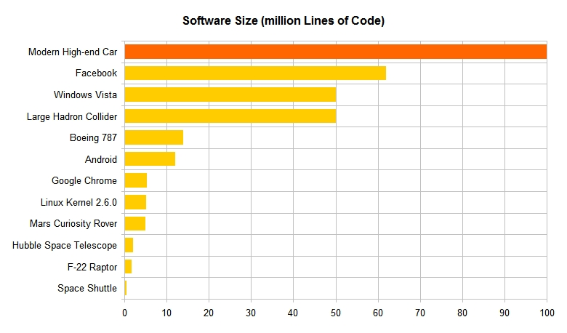
Lines of Code (Cont.)

Slide 4
Computer Communications

Slide 5
Computer Communications
Communications: the exchange of data between two devices via some form of transmission medium.
Telecommunication: communication at a distance, e.g. telephony, television and telegraphy.
Data: the information presented in whatever form that is agreed upon by the parties creating and using the data (text, numbers, images, audio, videos).

Slide 6
Computer Communication System
Communication devices must be part of a system, know as computer communication systems.
Communication systems are made up of a combination:
Hardware (physical equipment)
Software (programs)

Slide 7
Components of Computer Communication Systems
Message
Sender
Receiver
Medium
Protocol
1
Message
Hi, how are you?
5
Protocol
2
Sender
3
Receiver
4
Medium

Slide 8
Characteristics of Computer Communication Systems
Fundamental characteristics required in computer communication system for an effective communication:
Delivery: system must deliver data to the correct destination.
Accuracy: system must deliver data without alteration.
Timeliness: system must deliver data in a timely manner.
Jitter: system should have a proper variation in packets inter-arrival time to their destination.
*Jitter: usually referred for the uneven delay in delivery of packets.

Slide 9

Characteristics of Computer Communication Systems (Cont.)
Hi,
Hi,
how
how
are
are
you?
you?
Hi, how are you?
Hi, how are you?
Computer
01010001
01010001

Slide 10
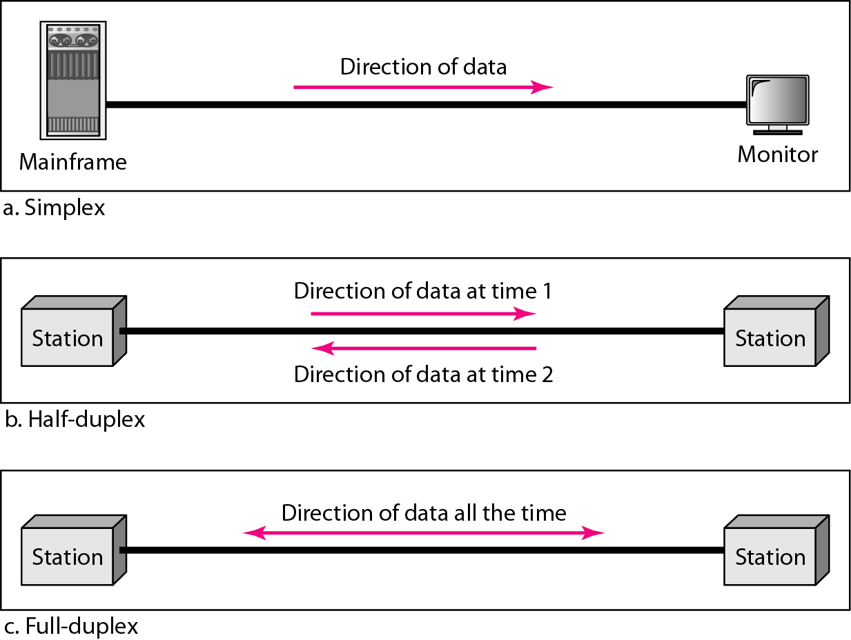
Data Flow Directions
Simplex: communication is uni-directional.
Half-duplex: each of both stations can transmit and receive but one at a time.
Full-duplex: each of both stations can transmit and receive simultaneously.

Slide 11
Networks

Slide 12
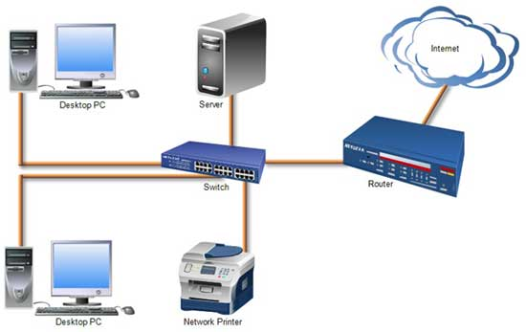
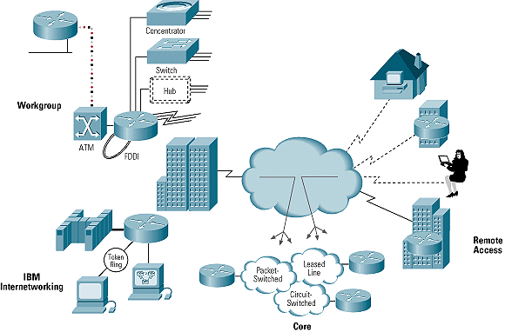
Networks
Network: is a set of devices (often referred to as nodes) connected by communication links.
Internetwork (Internet): the inter-connection of networks.

Slide 13
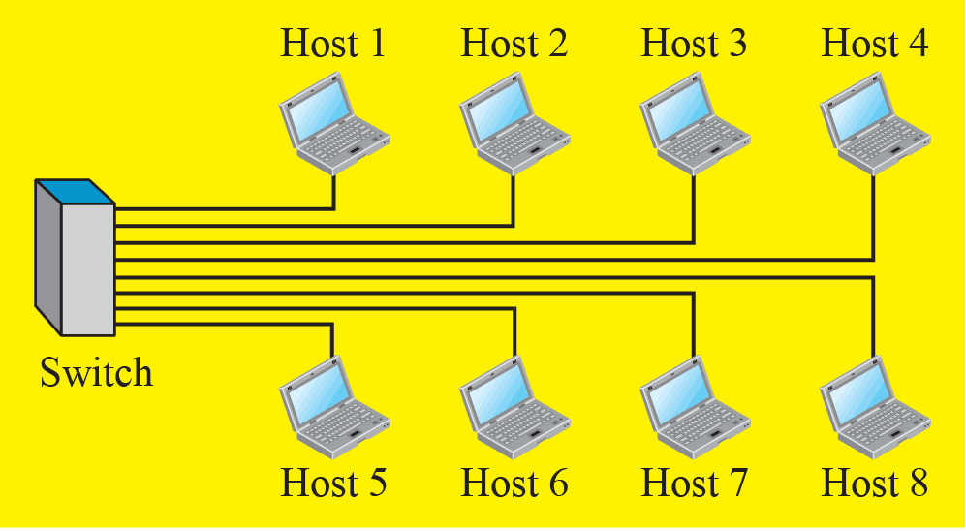
Type of Nodes
Types of nodes in a network:
A node can be a host (i.e. an end system), such as desktop, laptop, workstation, cellular phone, printer or any other device.
A node can be a connecting device such as router, switch and modem (modulator-demodulator).

Slide 14
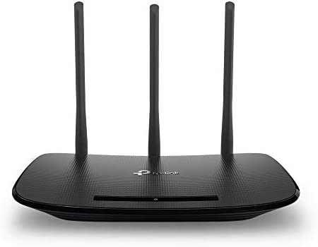
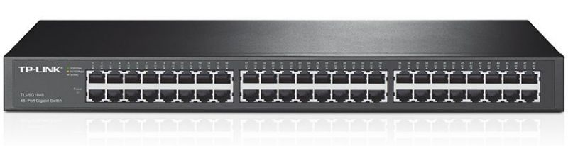

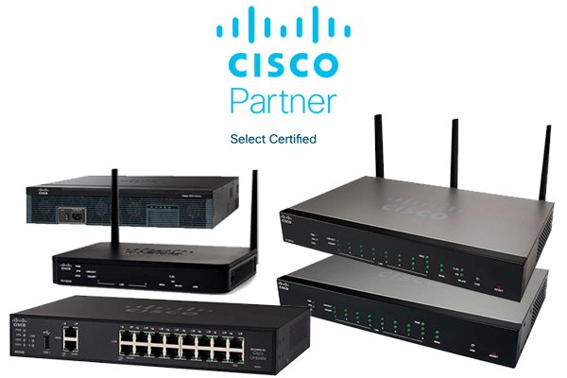
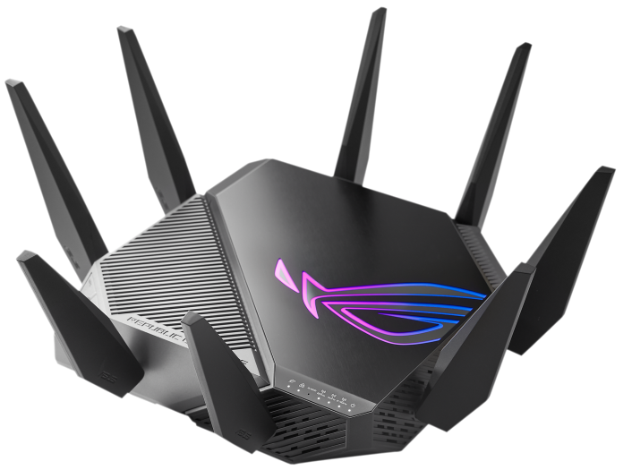
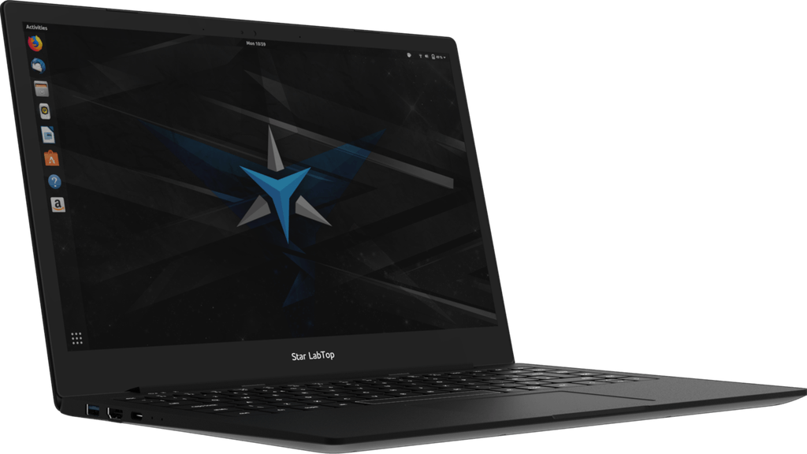
Type of Nodes (Cont.)

Slide 15
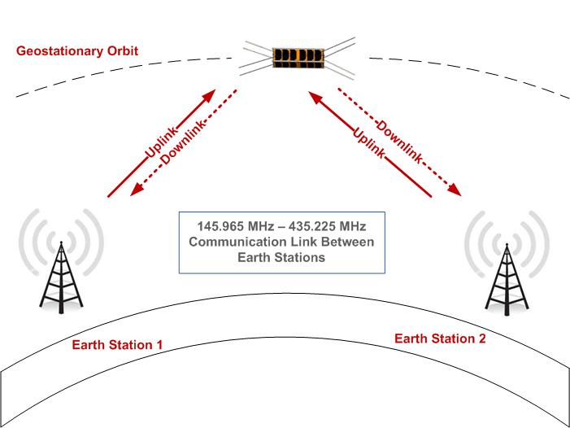
Link
Link: a “communication channel” that transfers data from one device to another.
A link can be a cable, air, optical fiber, or any medium which can transport a signal carrying information.

Slide 16
Physical Structures & Network Topologies

Slide 17
Physical Structures
Type of Connections:
Point-to-Point: dedicated “link” between two devices.
Single transmitter and single receiver.
Entire channel capacity is reserved for the two devices.
Mostly, they are actual wires or cables. However, wireless microware or satellite “links” are also possible.
Multipoint: more than two devices share a single “link”.
Multiple recipients of single transmission.
The channel capacity is shared.

Slide 18
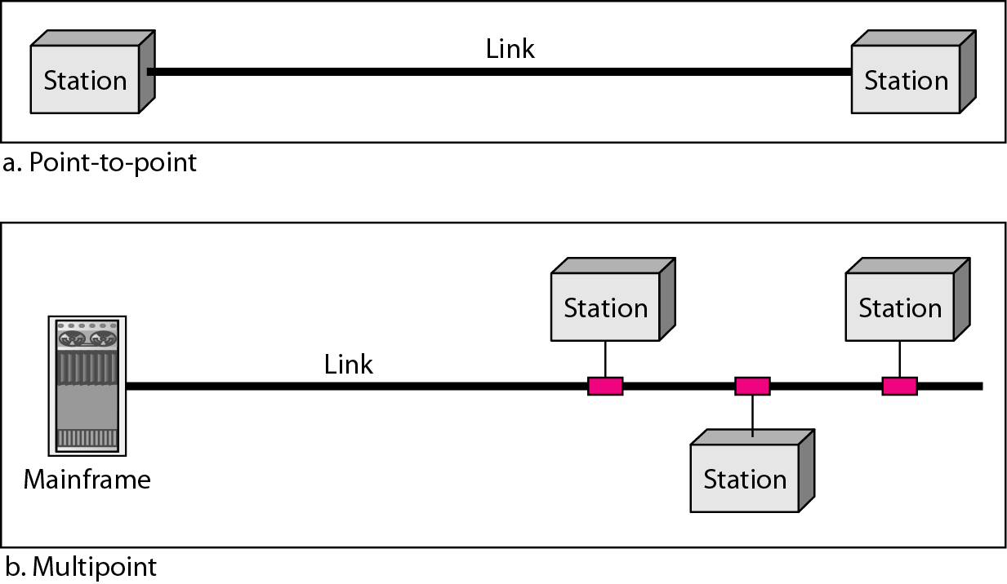
Physical Structures (Cont.)

Slide 19
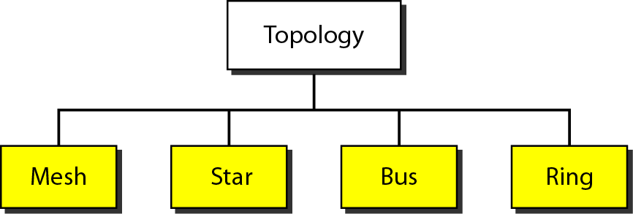
Physical Structures (Cont.)
Network Topology: the way the network is physically laid out.
Network Topology: the geometric representation of the relationship of all links and linking devices to one another.
Four basic topologies:

Slide 20
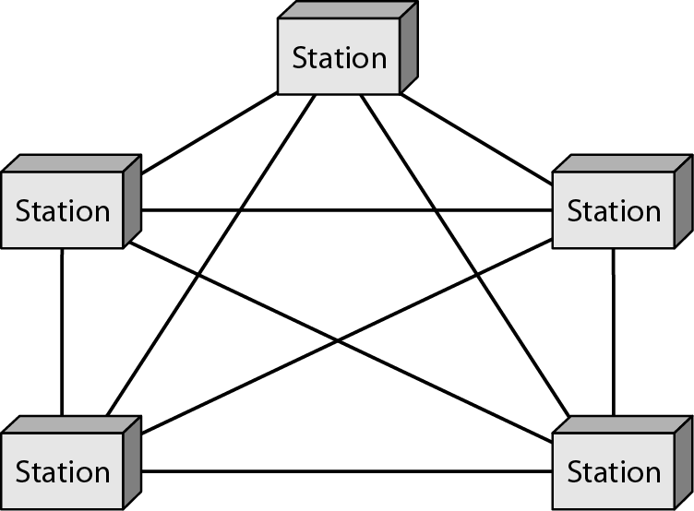
Mesh Topology
Every device has dedicated point-to-point link to every other device.
Number of links in a fully connected simplex mesh network with n nodes is n*(n-1). In duplex mode n*(n-1)/2.
Advantages: reliable, secure, robust,
easy fault isolation.
Disadvantages: costly, installation efforts.
Applications: backbone networks.
How many I/O (i.e. comm.) devices?

Slide 21
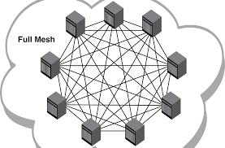
Mesh Topology (Cont.)

Slide 22
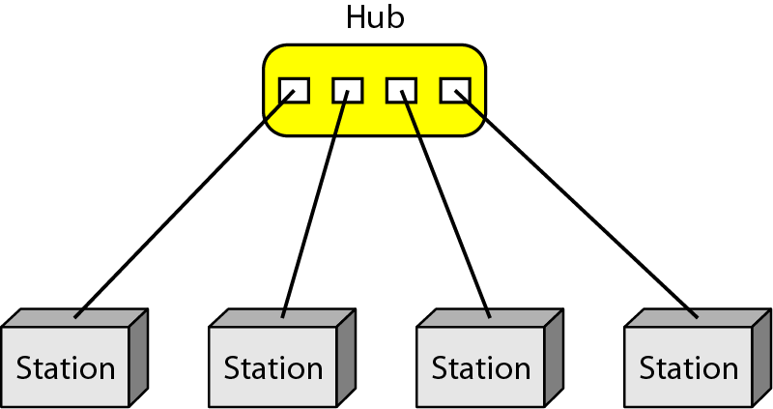
Star Topology
Every device has dedicated point-to-point link to a central controller.
Centrally controlled setup implies that devices are not directly connected to each other.
One link and one I/O is required at each device.
Advantages: less expensive and less resources required than mesh, easy fault isolation.
Disadvantages: controller loss.
Applications: Local Area Networks (LANs).

Slide 23
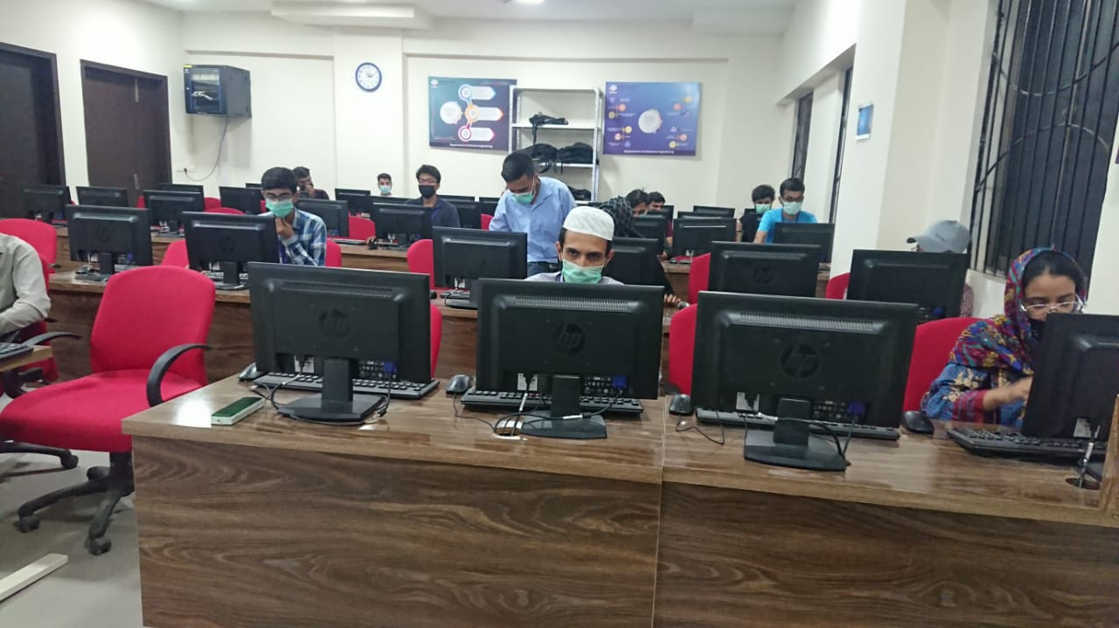
Star Topology (Cont.)

Slide 24
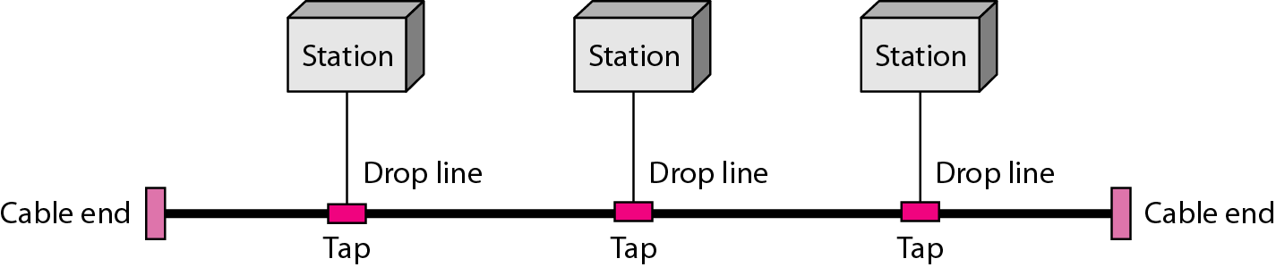
Bus Topology
Bus topology is a multipoint connection example.
Nodes connected to bus cable by drop lines and taps.
There are limitations on number of taps and distance between taps.
Advantages: easy to install, less resources than star.
Disadvantages: difficult reconnection, addition & fault isolation. Any break stops all transmission due to signal reflection.
Applications: traditional LANs, i.e. less popular nowadays.

Slide 25
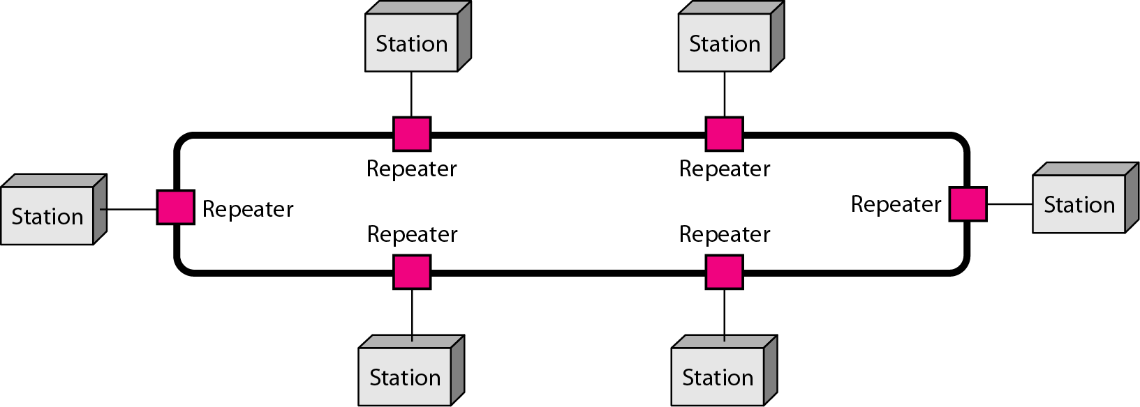
Ring Topology
Every device has a dedicated point-to-point connection with only the two devices on either side of it.
Signal passes in one direction.
Advantages: easy to install, addition, fault isolation.
Disadvantage: link break can
disable entire network.
Application: less popular.

Slide 26
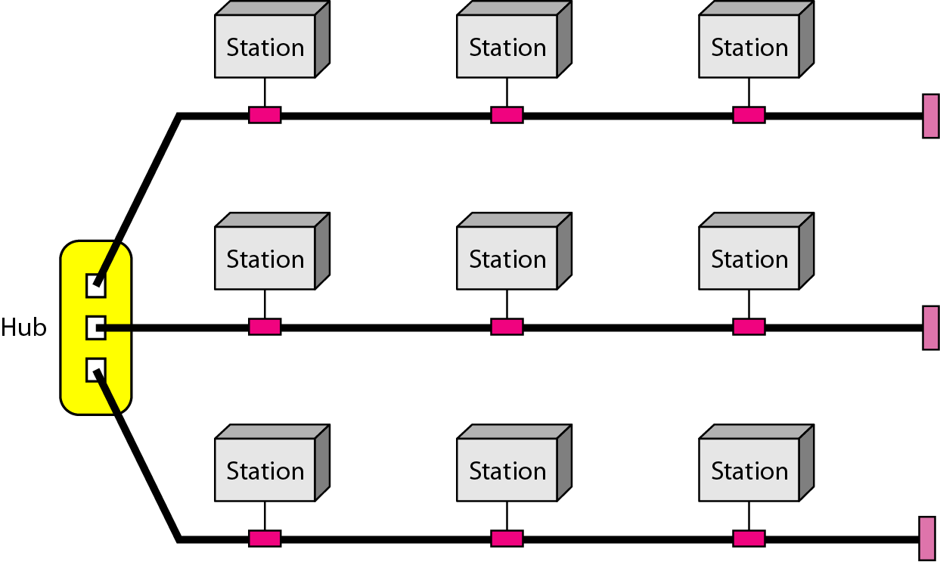
Hybrid Topology
The hybrid topology in the example below is a combination of a star backbone with three bus networks.

Slide 27
Network Categories

Slide 28
Categories of Networks
Categorizing networks in terms of size:
Personal Area Networks (PANs)
Short range (Approx 10 m).
Low power
Low cost
Local Area Networks (LANs)
Distances within coverage area of a building or a campus, (usually > 2 miles).
Designed to provide local interconnectivity.

Slide 29
Categories of Networks (Cont.)
Categorizing networks in terms of size (Cont.):
Metropolitan Area Networks (MANs)
Provide connectivity over areas such as a city (10s of miles), e.g. cable TV networks.
Wide Area Networks (WANs)
Long distances and provide connectivity over large areas, such as inter-cities, countries and continents.

Slide 30
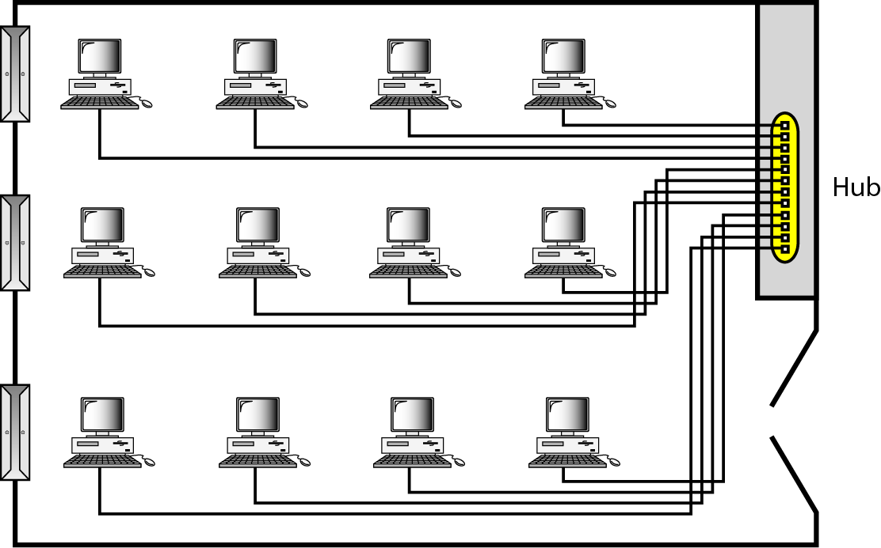
LAN Example
An isolated LAN connecting 12 computers to a switch in a closet.

Slide 31
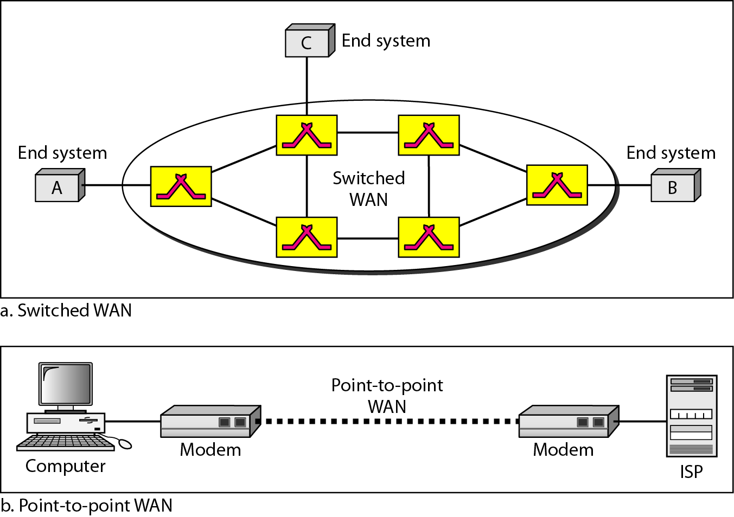
WAN Example
Switched WAN (internet).
Point-to-point WAN (leased line).

Slide 32
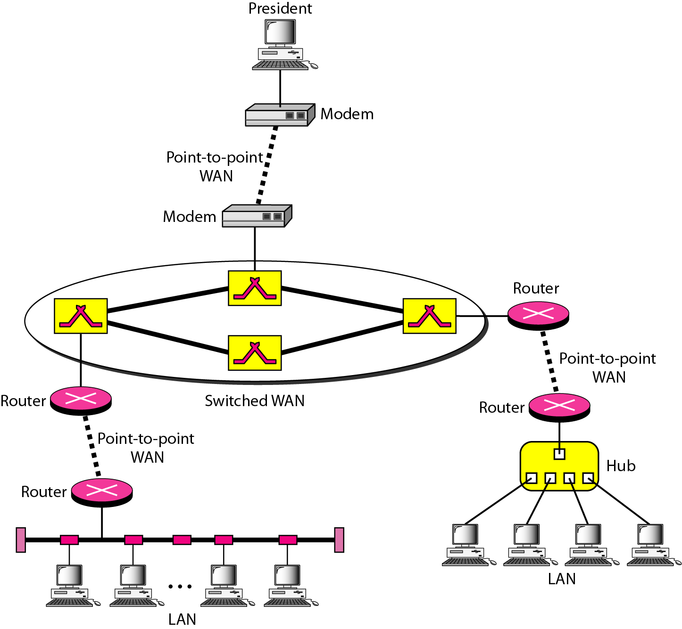
Heterogeneous Network Example
A heterogeneous network made of four WANs and two LANs.

Slide 33
Protocols
A protocol is synonymous with rule.
Protocol: set of rules that govern data communications.
Key elements of a protocol are syntax, semantics and timing.
Syntax: structure or format of the data which indicates how to read the bits or field description.
Semantics: interprets the meaning of the bits which identifies that which fields define what action.
Timing: it determines when the data should be sent and how fast.

Slide 34
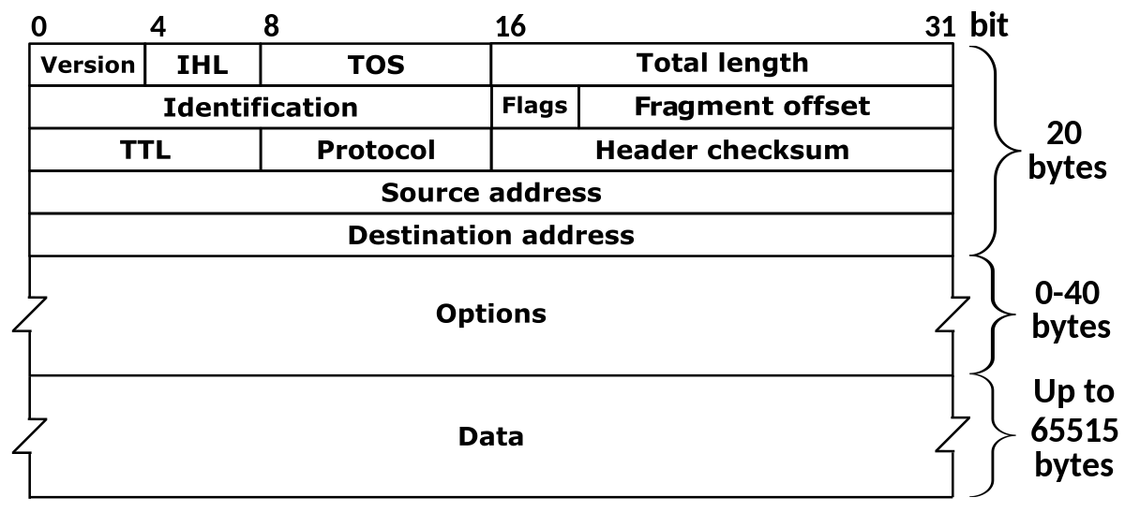
IP Header Example

Slide 35
Standards
Standards provide guidelines to manufacturers, vendors, government agencies and other service providers to ensure the interconnectivity that is necessary in today's marketplace.
Essential for guaranteeing national and international interoperability of data and telecommunications technology.
Data communication standards categories:
De facto (in practice) standards
→ Not approved but widely adopted
De jure (in law) standards
Approved by an organization

Slide 36
Standards Organizations
Standards Creation Committees:
International Organization of Standardization (ISO)
International Telecommunications Union – Telecommunication Standardization Sector (ITU – T)
Institute of Electrical and Electronic Engineers (IEEE)
Internet Engineering Task Force (IETF)
American National Standards Institute (ANSI)
Regulatory Agencies, e.g. Federal Communication Commission (FCC)
Forums, e.g. IoT, 6LoWPAN, ZigBee.

Slide 37
Thank You!

